Slide 1

Sentiment Analysis Tool for Twitter
A tool to identify public sentiment towards brands and products from Twitter data

Slide 2



Our Team
Tharun Prabhakar
Niranjan Kumar Kishore Kumar
Sumit Kumar
Lead AI Engineer
Lead AI Engineer
Lead AI consultant

Slide 3



Introduction
Sentiment Analysis for Client Products
Twitter Data as Input Source
Understand Public Perception
Leverage the vast amount of Twitter data to gain insights into public opinion.
Identify areas for improvement by understanding the sentiments towards products.
Develop a tool to analyze sentiments towards client products using Twitter data.
This slide introduces the project report outlining the development of a sentiment analysis tool for Twitter to help clients gain valuable insights into public sentiment towards their products.

Slide 4

Twitter, Inc.
Twitter is a social media platform that enables users to broadcast short messages called tweets. It is headquartered in San Francisco, California, and has a logo featuring a stylized blue bird.

Slide 5


About Dataset
Number of Entries
Missing Values
Sentiment Categories
Unique Companies
74,682
686 (in 'Tweet' column)
Positive, Neutral, Negative, Irrelevant
32
73,996 non-null entries
Negative most frequent
TomClancysRainbowSix most mentioned
*Context provided in the project report

Slide 6
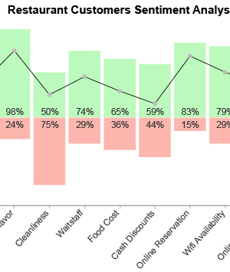
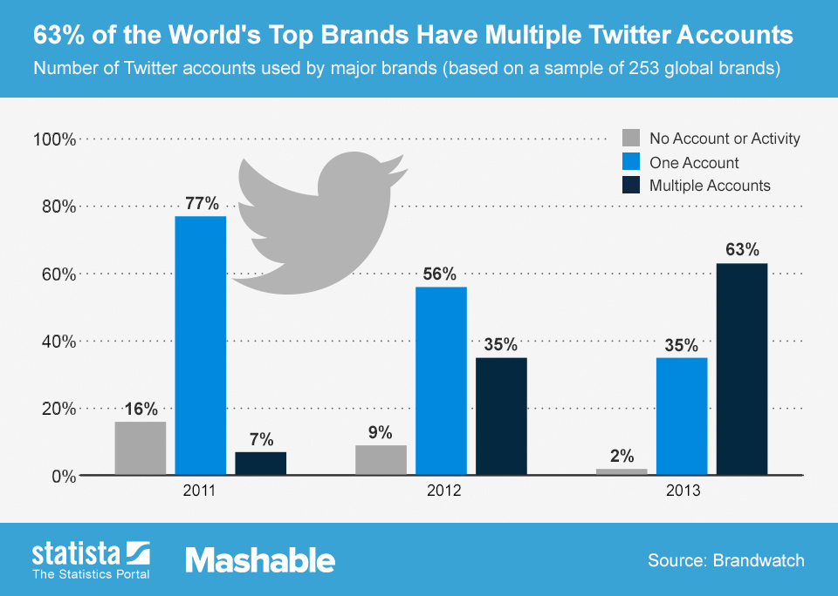
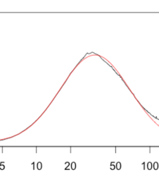
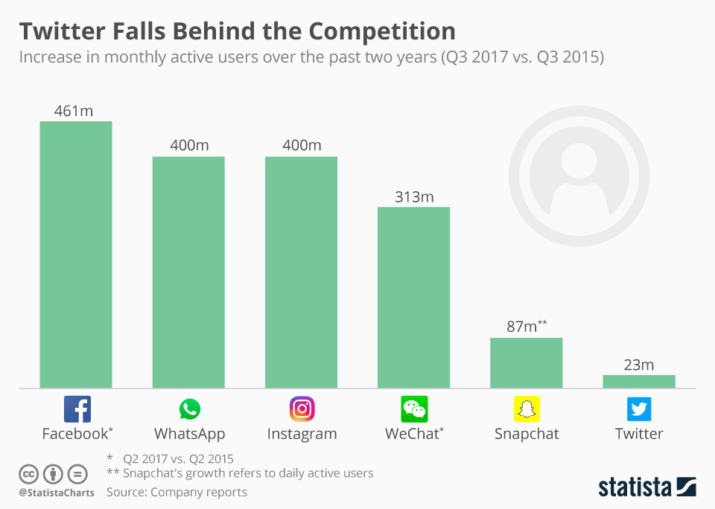
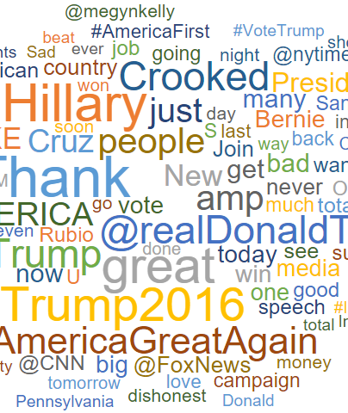
Exploratory Data Analysis
Distribution of Sentiment Labels
Top 10 Companies by Tweet Volume
Distribution of Tweet Lengths
Distribution of Tweets per Company
Word Cloud Visualization
A bar chart showing the distribution of sentiment labels, with negative sentiment being the most frequent, followed by positive, neutral, and irrelevant.
A horizontal bar chart displaying the top 10 companies with the highest number of tweets, with MaddenNFL having the highest volume.
A histogram showing the distribution of tweet lengths, with most tweets being relatively short, between 0 to 200 characters.
A bar chart depicting the number of tweets per company, with most companies having around 2240 to 2380 tweets, showing a consistent distribution.
A word cloud visualization highlighting the most frequent words in the dataset, including "game", "twitter", "play", "love", and company names like "Facebook" and "Verizon".

Slide 7
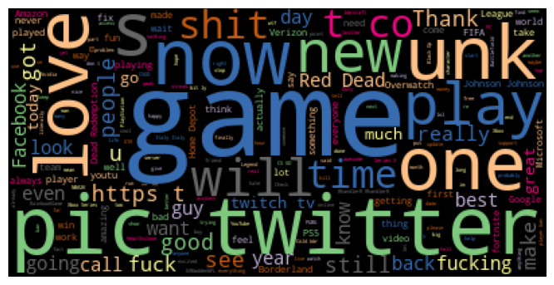
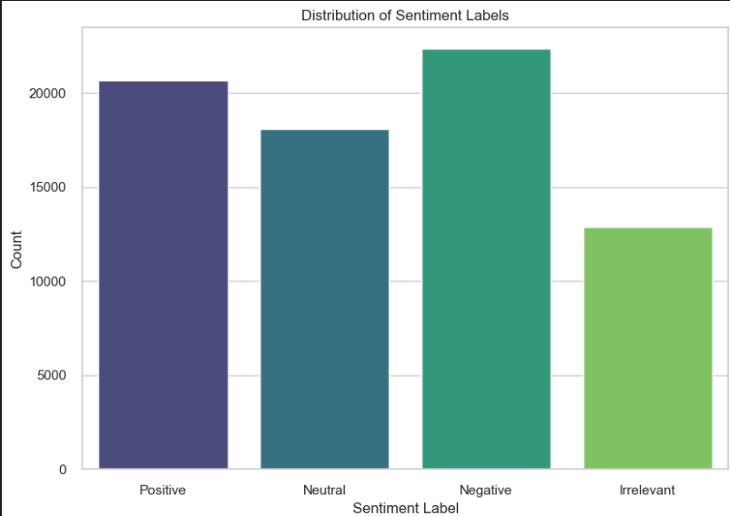
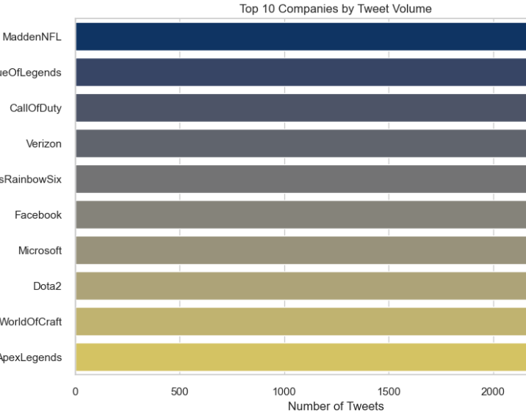
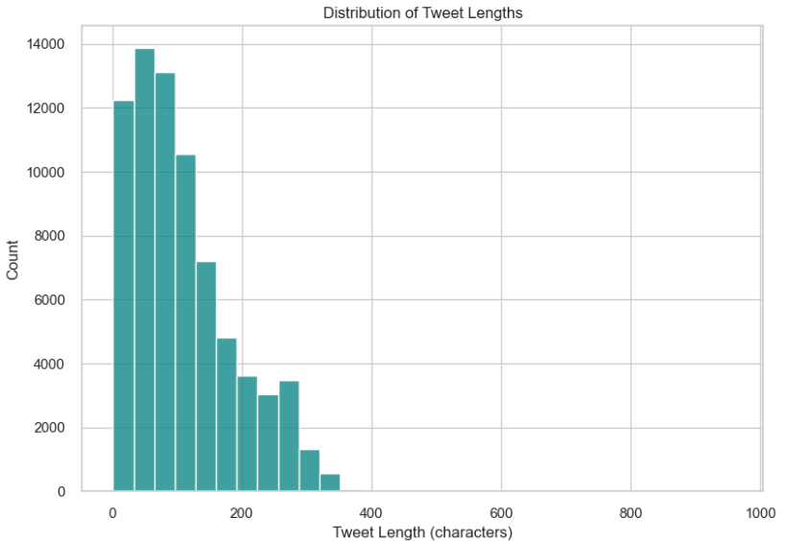
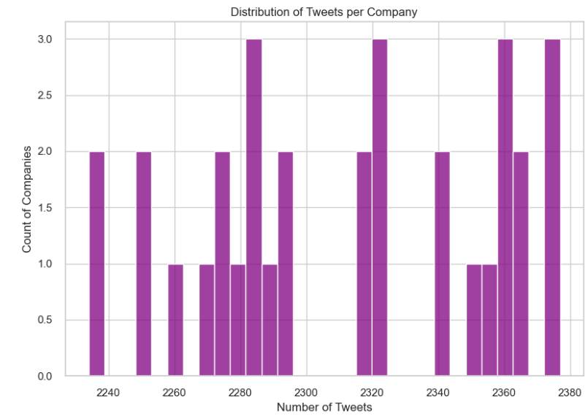

Slide 8




Data Pre-processing
Eliminate unwanted noise like URLs, hashtags, user mentions, and special characters that are not relevant for sentiment analysis.
Remove tweets with missing text data to avoid potential errors or bias.
Convert all text to lowercase to ensure uniformity and reduce variability.
Eliminate numbers from the text as they typically do not contribute to sentiment.
Remove URLs, Hashtags, Mentions, and Special Characters
Handle Missing Values
Lowercase Letters
Remove Numbers
Tokenize Text
Remove Stopwords
Lemmatization
Split the text into individual words (tokens) for further processing like removing stopwords and lemmatization.
Remove common words (stopwords) that do not contribute much to sentiment, such as 'and', 'the', 'is', etc.
Reduce words to their base or root form (lemma) to standardize and reduce dimensionality, e.g., 'running' becomes 'run'.

Slide 9
Models Tried
Decision Tree
A tree-based model that recursively partitions the data space based on feature values, creating a hierarchical structure of decisions. It is interpretable and can handle both numerical and categorical features, but may be prone to overfitting.
Random Forest
An ensemble learning method that combines multiple decision trees, trained on random subsets of features and data. It reduces overfitting, provides robust performance, and can handle high-dimensional data, but may be less interpretable than individual trees.
Gradient Boosting
An ensemble technique that iteratively combines weak models (decision trees) into a strong predictive model. It can effectively handle complex, non-linear relationships and is robust to outliers, but may be prone to overfitting and is less interpretable than individual trees.
AdaBoost
An ensemble boosting algorithm that iteratively trains weak classifiers (decision trees) and adjusts the data weights to focus on misclassified instances. It can improve performance on complex datasets but may be sensitive to noisy data and outliers.
Multinomial Naive Bayes
A probabilistic classifier based on Bayes' theorem, specifically designed for text classification tasks. It assumes feature independence and calculates probabilities for each class, providing a simple and efficient approach, but may perform poorly when the feature independence assumption is violated.

Slide 10
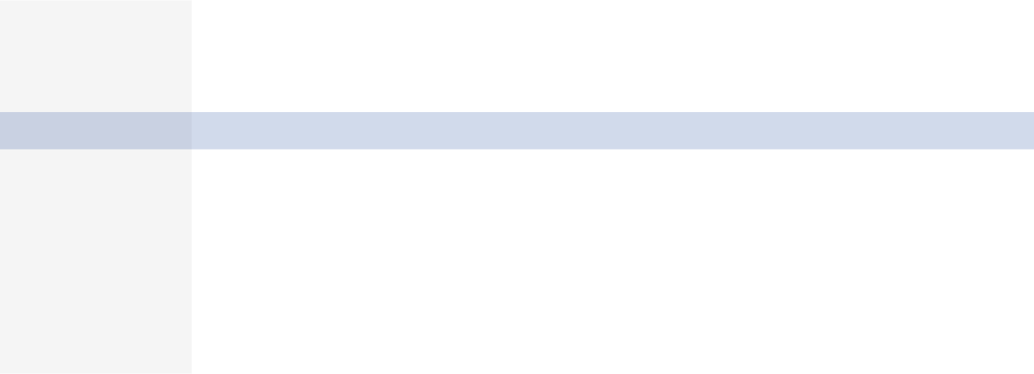

COMPARISON STATISTICS
Model
Misclass
Precision
Recall
Train Accuracy
Test Accuracy
F1 Score
AUC Score
Val Accuracy
Precision
Recall
F1 Score
AUC Score
DecisionTreeClassifier_TF
3,290
0.78
0.78
0.97
0.78
0.78
0.87
0.92
0.92
0.92
0.92
0.95
RandomForestClassifier_TF
1,554
0.9
0.9
0.97
0.9
0.89
0.98
0.97
0.97
0.97
0.97
1
GradientBoostingClassifier_TF
7,212
0.56
0.51
0.54
0.51
0.48
0.77
0.55
0.61
0.55
0.53
0.81
AdaBoostClassifier_TF
8,138
0.48
0.45
0.46
0.45
0.41
0.67
0.45
0.51
0.45
0.41
0.7
MultinomialNB_TF
4,592
0.74
0.69
0.76
0.69
0.67
0.91
0.79
0.82
0.79
0.78
0.96
DecisionTreeClassifier_CV
2,910
0.81
0.8
0.97
0.8
0.8
0.89
0.94
0.94
0.94
0.94
0.97
RandomForestClassifier_CV
1,645
0.89
0.89
0.97
0.89
0.89
0.98
0.97
0.97
0.97
0.97
1
GradientBoostingClassifier_CV
7,305
0.56
0.51
0.53
0.51
0.47
0.76
0.55
0.62
0.55
0.53
0.81
AdaBoostClassifier_CV
8,146
0.48
0.45
0.46
0.45
0.41
0.68
0.45
0.48
0.45
0.41
0.7
MultinomialNB_CV
4,203
0.73
0.72
0.78
0.72
0.71
0.9
0.81
0.82
0.81
0.8
0.95

Slide 11
Evaluation Metric
Accuracy
Measures the overall correctness of the model's predictions.
Precision
Measures the proportion of correct positive predictions among all positive predictions, avoiding false positives.
Recall
Measures the proportion of correct positive predictions among all actual positive instances, capturing all positive cases.
F1 Score
Balances precision and recall, providing a single metric considering both false positives and false negatives.
AUC Score
Measures the model's ability to discriminate between positive and negative classes, useful for imbalanced datasets.

Slide 12
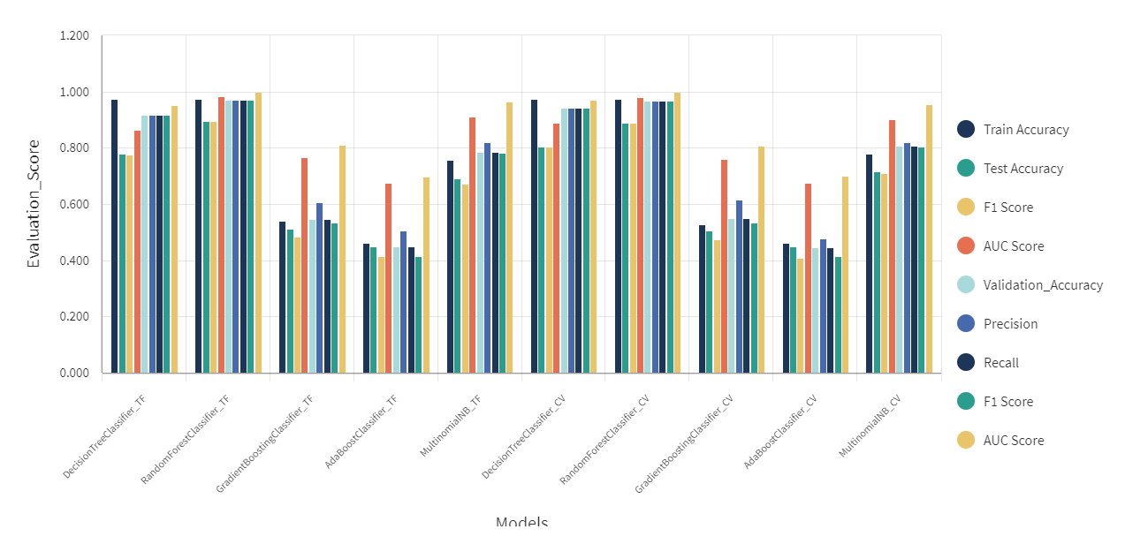
EVALUATION METRICS

Slide 13


Client Recommendation
Precision
Recall
F1 Score

Slide 14
Future Work
Q3 2025
Q3 2024
Q1 2025
Implement deep learning-based approaches for improved feature extraction.
Explore advanced text preprocessing techniques like word embeddings.
Conduct extensive hyperparameter tuning for optimized model performance.
Q4 2024
Q2 2025
Experiment with ensemble techniques like stacking or blending.
Investigate domain-specific lexicons for sentiment analysis in diverse industries.

Slide 15
Model Deployment
Web Service / API
Integration into Existing Systems
Scalability
Deploy the trained model as a web service or RESTful API using frameworks like Flask or Django. This allows integration with various applications and systems.
Ensure the deployment infrastructure can handle increasing demand and traffic by implementing load balancing, auto-scaling, and distributed computing techniques.
Incorporate the model into Twitter's existing infrastructure, platforms, or applications using libraries like TensorFlow Serving or FastAPI for seamless integration.
Low Latency
Security
Monitoring and Maintenance
Optimize the model for low inference latency to provide real-time or near-real-time sentiment analysis, ensuring a smooth user experience.
Implement robust security measures, such as authentication, encryption, and access control, to protect the model and the data it processes.
Continuously monitor the model's performance, accuracy, and drift over time. Regularly update and retrain the model with new data to maintain its effectiveness.

